Slide 1
Activity Diagrams
What is an Activity?
Activity Diagrams – Notation
Activity Diagrams – 5 Examples

Slide 2
Activity Diagram
Activity diagram is used for business process modelling,modelling the logic captured by a single use case or scenario or modelling a detailed logic of business rule.
Easiest way to visualize an activity diagram is to think of a flowchart and DFD’s

Slide 3
What is an Activity?
In a conceptual diagram, an activity is some task that needs to be done, whether by a human or a computer
Activity arrangement
Sequential – one activity is followed by another
Parallel – two or more sets of activities are performed concurrently, and order is irrelevant
Interleaving is permitted – we can jump between the parallel flows

Slide 4
What is an Activity Diagram?
Activity diagrams represent the dynamic (behavioral) view of a system
Activity diagrams are typically used for business (transaction) process modeling and modeling the logic captured by a single use-case or usage scenario
Activity diagram is used to represent the flow across use cases or to represent flow within a particular use case
UML activity diagrams are the object oriented equivalent of flow chart and data flow diagrams in function-oriented design approach
Activity diagram contains activities, transitions between activities, decision points, synchronization bars, swim lanes and many more…

Slide 5
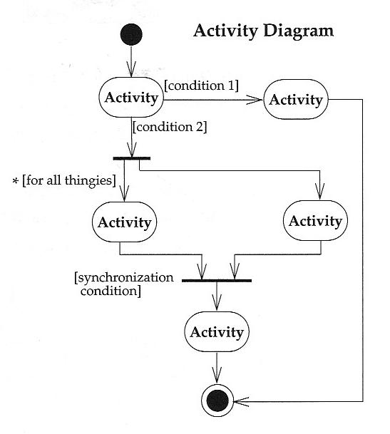
Activity Diagrams - Notation
Start at the top black circle
If condition 1 is TRUE, go right; if condition 2 is TRUE, go down
At first bar (a synchronization bar), break apart to follow 2 parallel paths
At second bar, come together to proceed only when both parallel activities are done

Slide 6
Student Enrollment in IIT (SEIIT)

Slide 7
SEIIT System
Here different activities are:
Received enrollment form filled by the student
Registrar checks the form
Input data to the system
System authenticate the environment
Pay fees by the student
Registrar checks the amount to be remitted and prepare a bill
System acknowledge fee receipts and print receipt
Hostel allotment
Allot hostel
Receive hostel charge
Allot room
Medical check up
Create hostel record
Conduct medical bill
Enter record
Issue library card
Issue identity card

Slide 8
Activity Diagram for the Use Case in SEIIT

Slide 9
Basic Components in an Activity Diagram
Fork
A black bar ( horizontal/vertical ) with one flow going into it and several leaving it. This denotes the beginning of parallel activities
Join
A block bar with several flows entering it and one leaving it. this denotes the end of parallel activities
Merge
A diamond with several flows entering and one leaving. The implication is that all incoming flow to reach this point until processing continues

Slide 10
Detailed Activity Diagram of SEIIT

Slide 11
Detailed Activity Diagram of SEIIT

Slide 12
Detailed Activity Diagram of SEIIT

Slide 13
Activity Diagram of SEIIT with Swim Lane

Slide 14
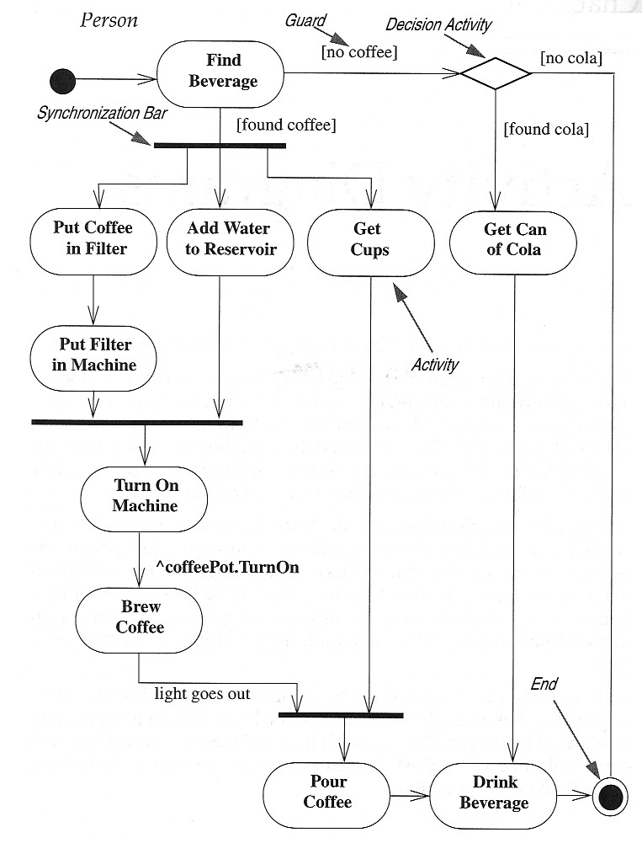
Activity Diagram

Slide 15
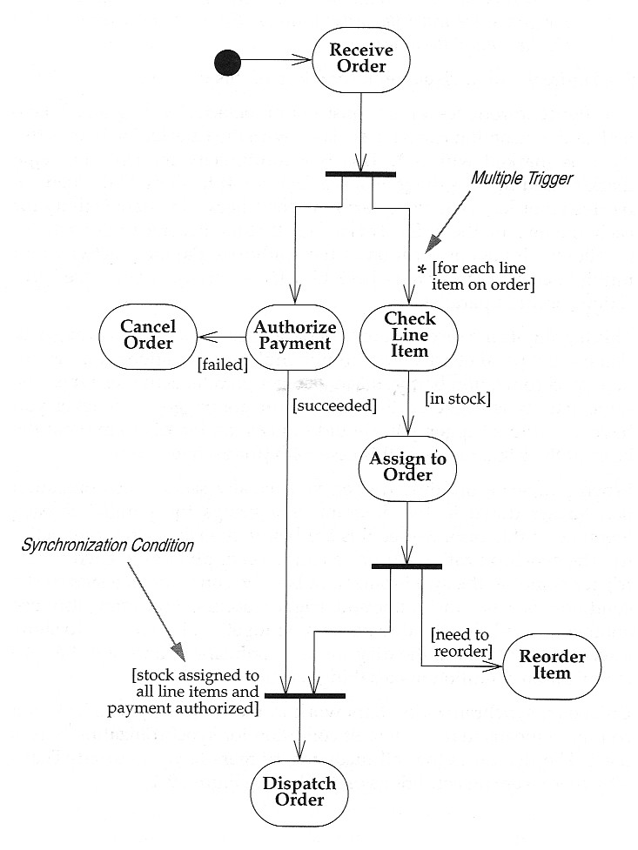
Activity Diagrams –
Use Case: Receiving an Order

Slide 16
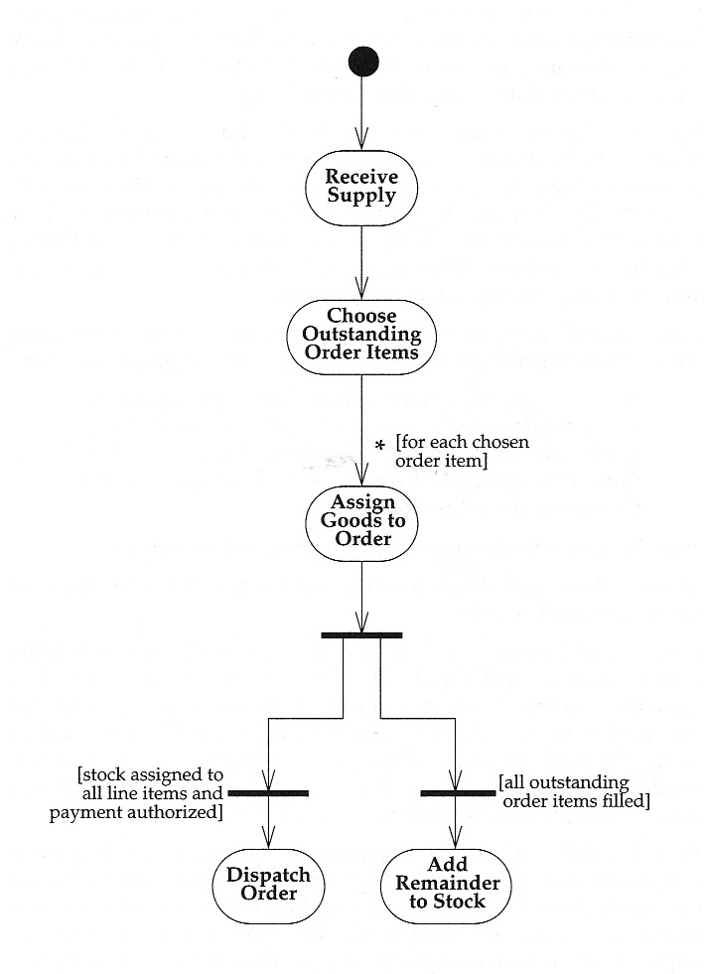
Activity Diagram – Example 2 of 5
Use Case: Receiving a Supply

Slide 17
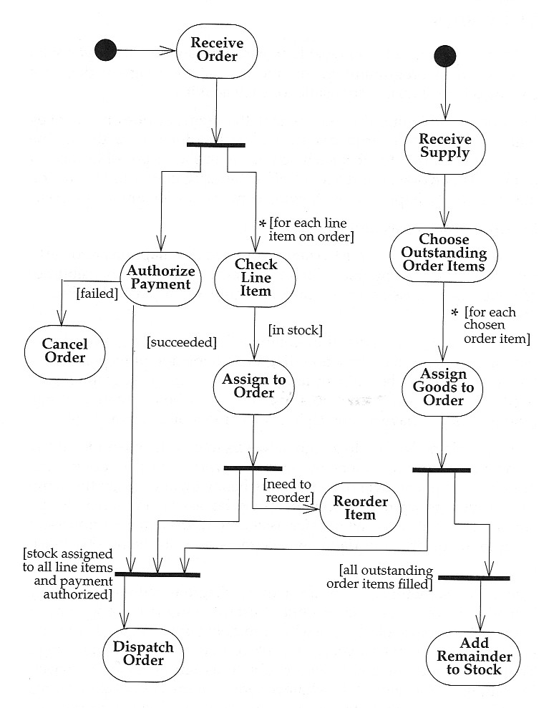
Activity Diagram – Example 3 of 5
Use Case: Receiving an Order and Receiving a Supply

Slide 18
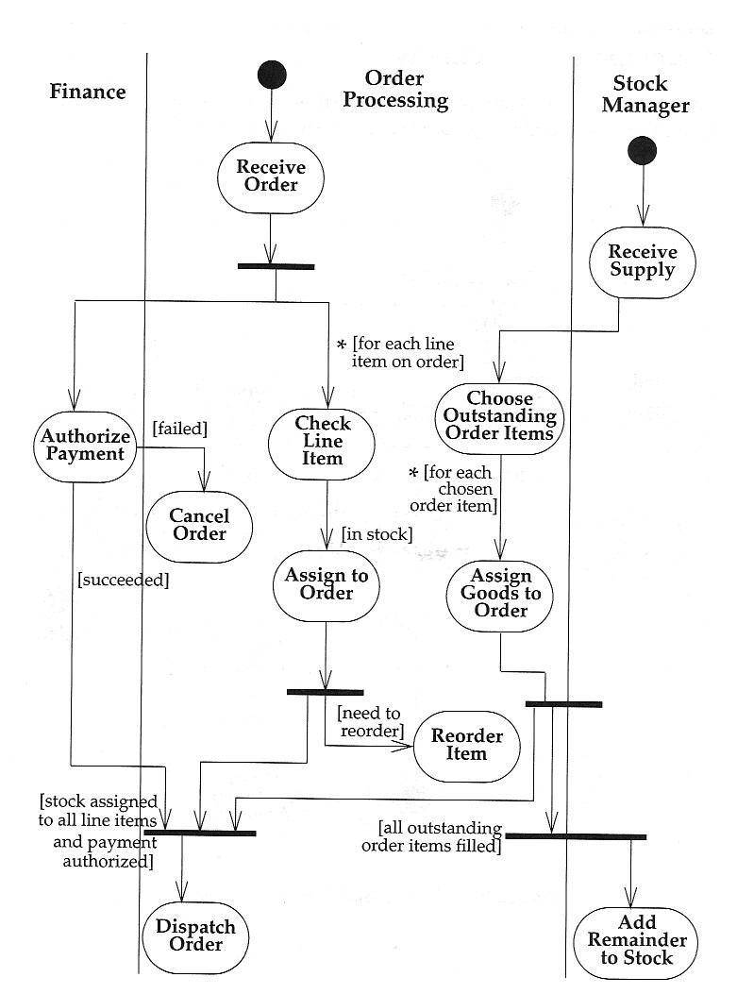
Activity Diagram
Swimlanes - Activity Diagrams that show activities by class
Arrange activity diagrams into vertical zones separated by lines
Each zone represents the responsibilities of a particular class (in this example, a particular department)

Slide 19
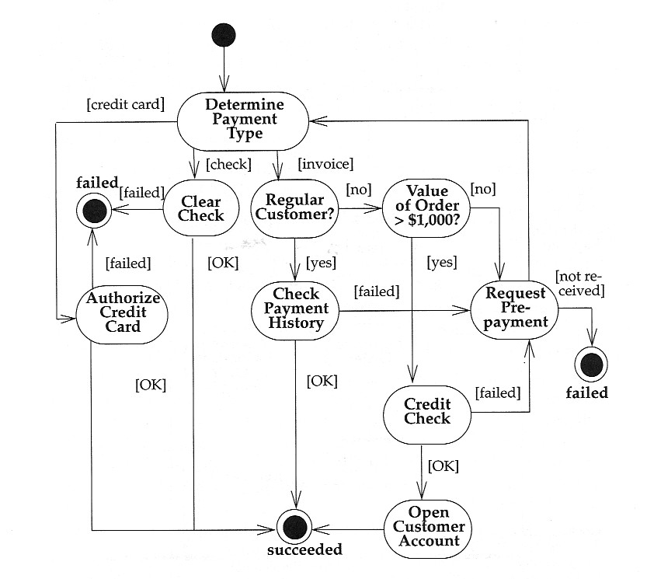
Activity Diagram
Decomposing an Activity
An activity can be decomposed into a further Activity Diagram
When an Activity Diagram represents a decomposition of a higher-level activity, there can be only one start point

